Slide 1
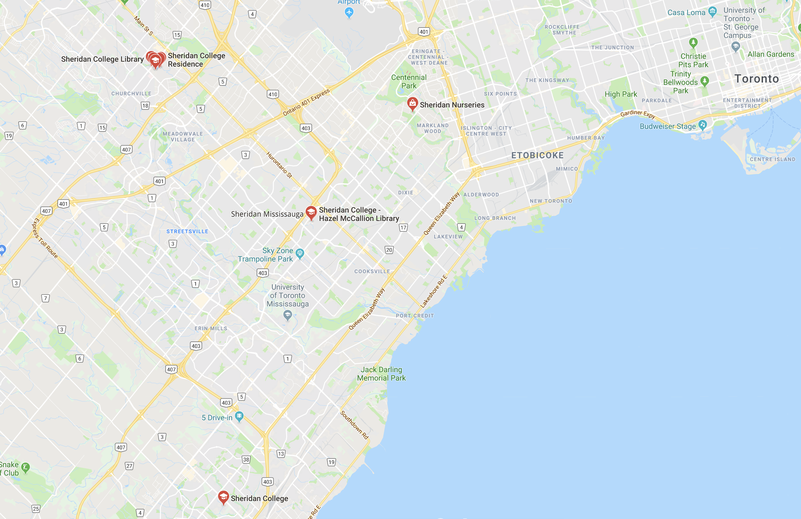
Sheridan eRide

Slide 2
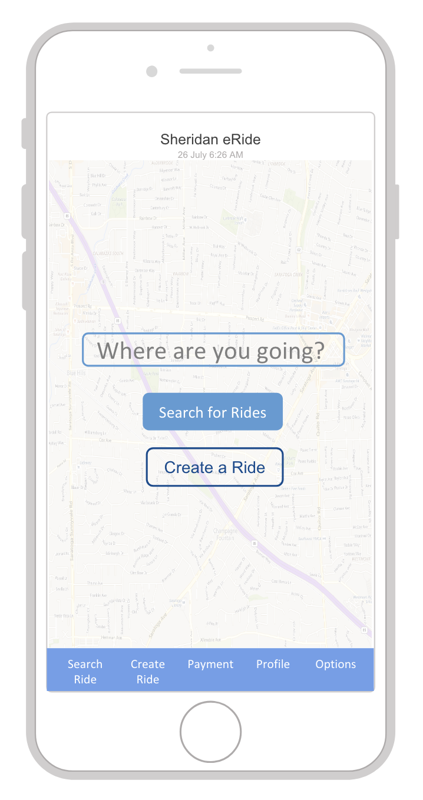
What is Sheridan eRide?
Sheridan eRide is a paid ridesharing service for Sheridan students.
With Sheridan eRide, students can opt to be drivers or passengers and share their rides with others.
Sheridan eRide provides an alternative to public transportation and private vehicle ownership.

Slide 3
Findings from User Survey
Top ranked
Background screening for drivers
Real time map
Posting and messaging systems
Profile and chat system
OneCard payment option
Lowest ranked
“Shuttle” services along popular routes
Service for transporting luggage/belongings
Ability to set preferences (e.g. “no talking”)
Features not considered
Bookmarking favourite drivers
Setting schedules
Option to choose driver’s gender and distance away
Personality matching

Slide 4
What Went Well
Users were happy with our design.
No one had a hard time logging in.
No one had a hard time finding Payment on the taskbar.
A small majority of users found the Search for Ride screen with ease.

Slide 5
What Didn’t Go Well
We thought Creating and Searching for Rides would be simple tasks. They weren’t.
Not everyone has used Uber or Lyft. The “Current Location -> Where to?” input boxes weren’t self-explanatory.
We assumed the concept of favourites (e.g. school/home) would be intuitive and thus didn’t require explanation. This wasn’t the case.
We assumed everyone was familiar with OneCard. Not true.
We didn’t realize how important confirmation popups were.

Slide 6
Initial Wireframes vs. Revised Wireframes

Slide 7

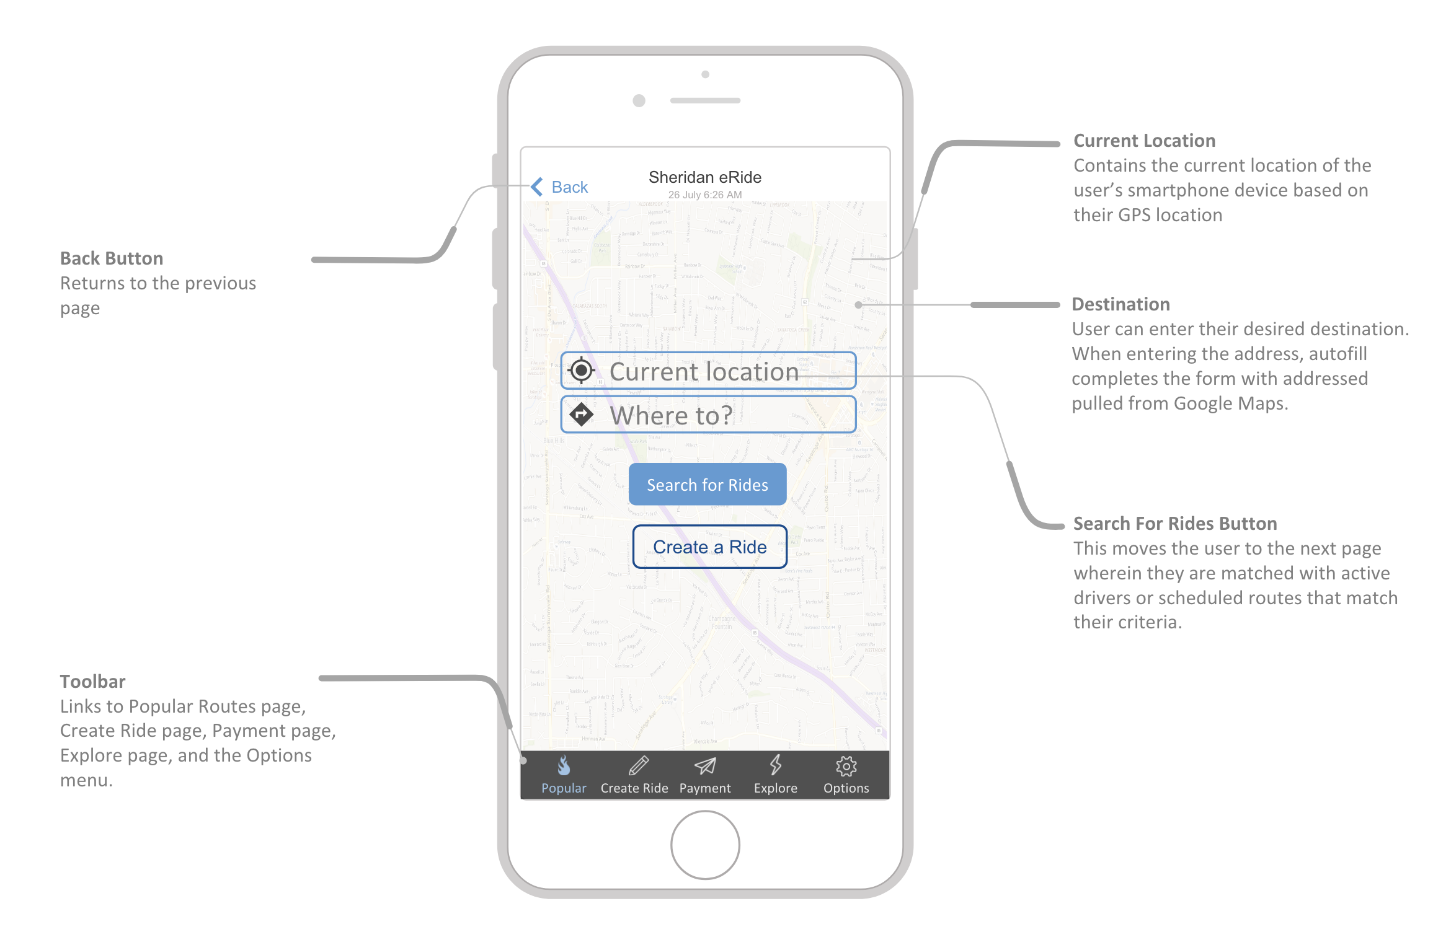
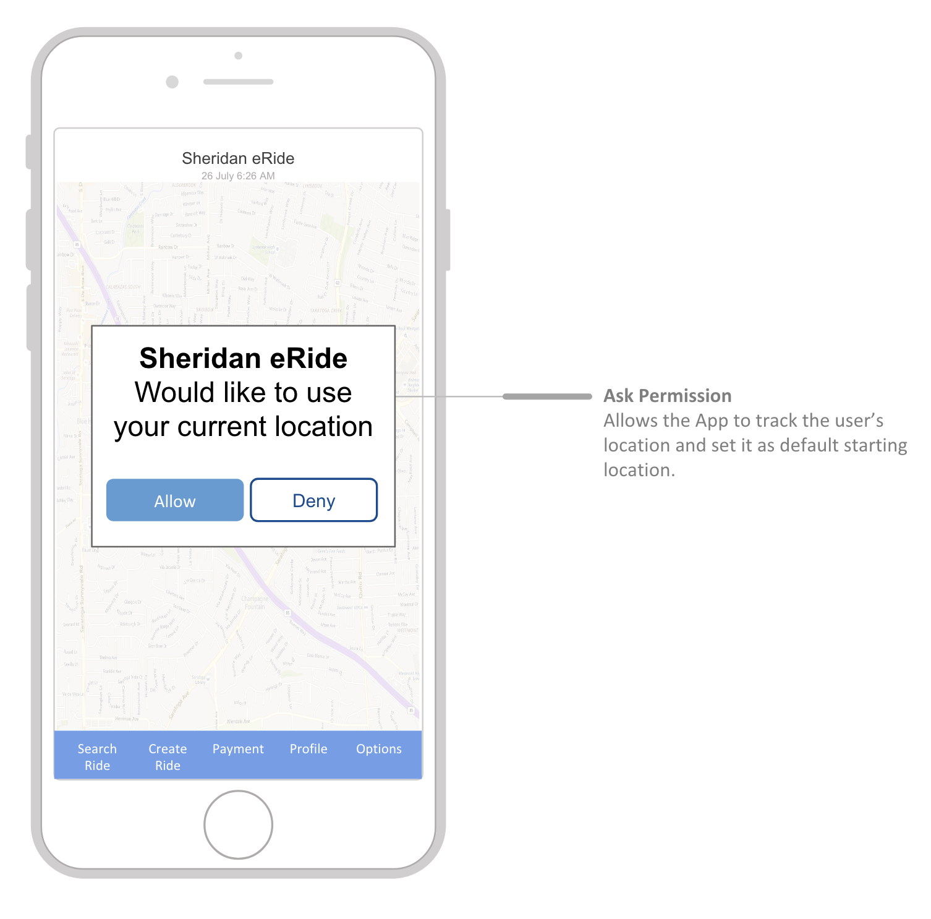
Set Destination
We realized that “Current Location” on its own wasn’t intuitive, and that it would be better to set “Current Location” as default only after asking the user for permission to access their location first.

Slide 8
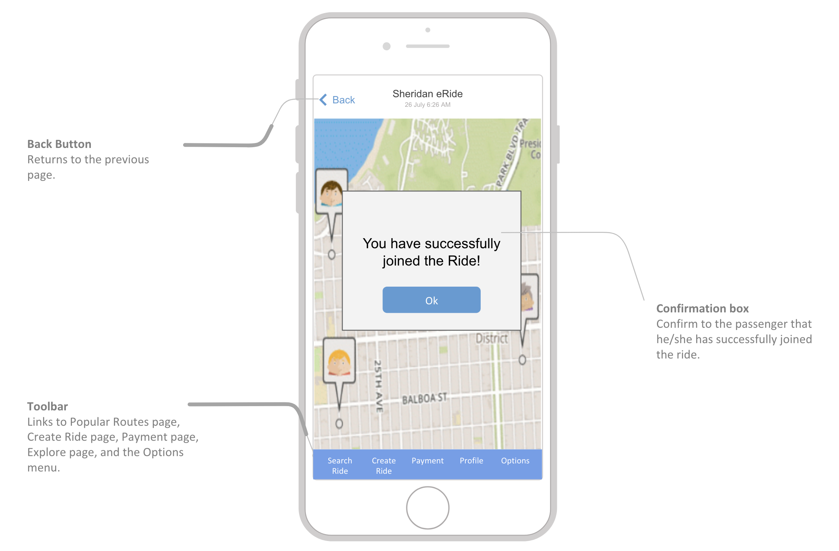
Joined Ride Confirmation
During our user testing phase, we learned that a lot of people were confused by the lack of confirmation when joining a ride.
We solved this by creating a confirmation popup before taking the user to the real time map screen.

Slide 9
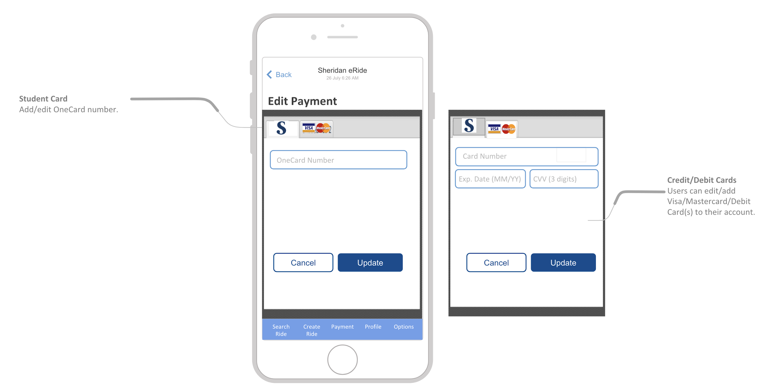
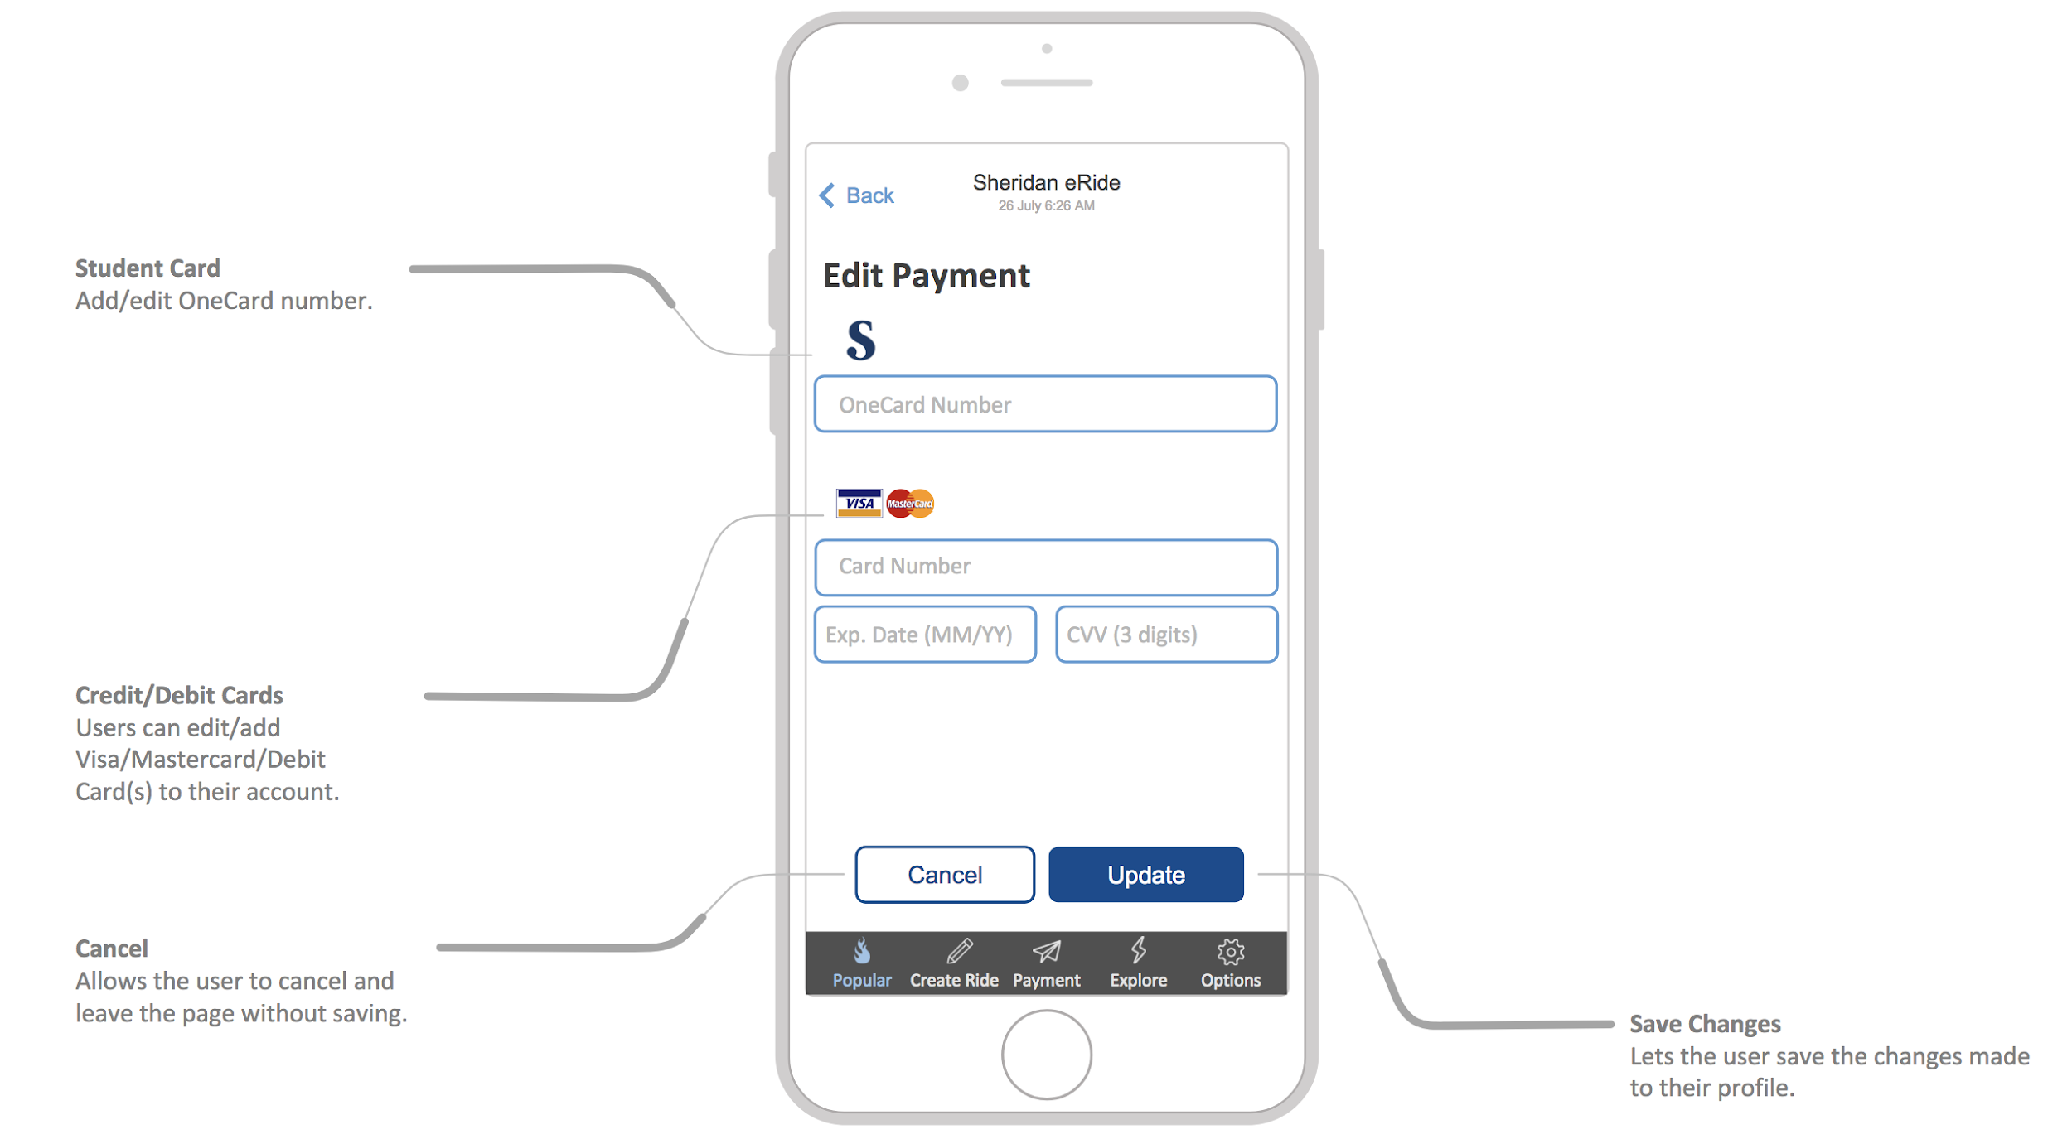
Payment
A few users found the payment page confusing as there were two payment input boxes on the same page. As some students were not familiar with OneCard, they weren’t sure what the first input box was for or whether both needed to be completed.

Slide 10
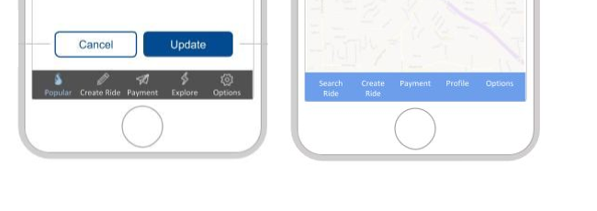
Toolbar
Options like ‘Popular’ and ‘Explore’ (for finding routes) confused users, and important pages like Search Ride and Profile were hidden inside of menus. To make these important tasks easier, we redesigned the toolbar.

Slide 11
Lessons Learned
Just because it’s intuitive to you, doesn’t mean it’s intuitive for everybody.
Feedback in the form of confirmation popups is important.
Did I just create that ride?
Not everyone understands the intention.
We thought the OneCard vs. Credit Card options on the Payment page were self-explanatory.
User testing is important!
Our app wouldn’t be as user friendly without it.

